Slide 1
MoNDE: Mixture of Near-Data Experts for Large-Scale Sparse Models
Taehyun Kim^{1,2}, Kwanseok Choi¹, Youngmock Cho^{1,2},
Jaehoon Cho¹, Hyuk-Jae Lee^{1,2}, Jaewoong Sim¹
¹Seoul National University ²Inter-University Semiconductor Research Center
Notes:
Hello, my name is Taehyun Kim.
I’d like to present our work, “MoNDE, Mixture of Near-Data Experts for Large-Scale Sparse Models”.
This work was conducted by my colleagues, supervisors and myself at Seoul National University.

Slide 2
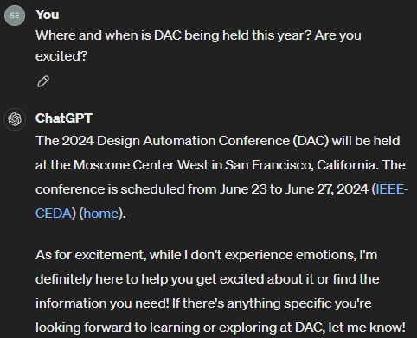

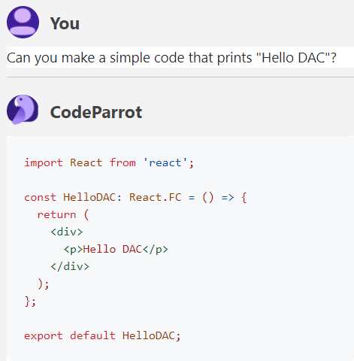
Large Language Models in our Daily Lives
Question Answering
Machine Translation
Code Generation
Notes:
Over the recent years, Transformer-based large language models, or LLMs, have revolutionized the use of AI in our daily lives.
Today, we can easily access LLM services for tasks such as question answering, machine translation, and software code generation.

Slide 3
Large Language Models in our Daily Lives
Moore’s Law for NLPs : “Model sizes increase exponentially every year”
Budget
Shortage
Notes:
This outstanding model performance can largely be attributed to unprecedented model sizes, which are expected to grow exponentially every year. //
However, scaling model capacity inevitably leads to an increase in computational costs and memory requirements, // making it increasingly difficult to train and serve due to limited hardware budgets.

Slide 4


Mixture-of-Experts (MoE)
Scale model capacity without proportionally increasing computation
Transformer Block
MoE FFN
Dense FFN
Expert
FFN₁
Expert
FFN₂
Expert
FFN₃
Fixed-complexity computation
Linear2
token₁
token₁
token₁
token₂
token₂
token₁
token₁
× B
token₁
Activation
token₂
token₃
token₂
Dense↔MoE
Conversion
token₃
Large memory
complexity
Linear1
Top-2
Gating
Gating
Attention
Input Tokens
1
1
2
2
3
3
Notes:
Recently, mixture-of-experts, or in short MoE, has been applied to large language models in order to scale model capacity without proportionally increasing the computation.
//
The original transformer model architecture mainly consists of multiple transformer blocks, which is each made up of an attention module and feedforward network., or in short FFN.
//
In MoE Transformers, the FFN is duplicated into multiple experts, each corresponding to a dense FFN.
// // // //
A gating network is added to map each input token to k experts to process the token.
The computational load is analogous to k dense networks, instead of being proportional to the total number of experts.
//
Although MoE offers the promise of fixed-complexity computation, the large memory complexity remains a challenge.

Slide 5
Mixture-of-Experts (MoE)
Significant memory demands that scale to expert and embedding sizes
4× NVIDIA A100 (320 GB)
1× NVIDIA A100 (80 GB)
Scales linearly to the
number of experts
Scales quadratically to the embedding size
Notes:
In particular, MoE large language models have significant memory demands that scale to expert and embedding sizes.
//
Because memory requirement scales linearly to the number of experts, // MoEs that adopt hundreds of experts may easily surpass the memory capacity of a single commodity GPU or even multi-GPU settings.
//
In addition, the memory requirement scales quadratically to embedding sizes.
//
Compared to the data volume of 6144 tokens which scales only linearly, the size of every expert module scales much faster.

Slide 6
Existing Solution : Expert Parallelism
64 experts / 1 GPU → 16 experts / GPU × 4 GPUs
GPU1
GPU1
GPU2
GPU3
GPU4
Token 1
Token 1
Experts
1-16
Experts
1-64
Experts
17-32
Experts
32-48
Experts
49-64
Gate
Gate
Token 1
Token 1
Expert Parallelism and its Resource-Inefficiency
Notes:
To combat large memory requirements of large MoEs, // expert parallelism in multi-GPU settings equally divides experts across GPUs.
When an expert in another GPU is activated, the input and output tokens are transferred back and forth the associated GPUs for processing the activated expert.

Slide 7
Existing Solution : Expert Parallelism
Valuable GPUs used for storing expert data, not utilizing the compute
GPU1
GPU2
GPU3
GPU4
Idle
Idle
Idle
Token 1
Experts
1-16
Experts
17-32
Experts
32-48
Experts
49-64
Gate
Token 1
Expert Parallelism and its Resource-Inefficiency
Notes:
However, expert parallelism could result in high GPU underutilization especially in low-batch inference settings, since GPUs without activated experts are idle during expert processing.
This means that valuable GPUs are used mainly for storing expert data and not utilizing the compute capabilities of the GPUs, which is resource-inefficient.

Slide 8
Existing Solution : Expert Offloading
GPU
2 TB/s
HBM
80 GB
32 GB/s
PCIe
Bus
Bottleneck
CPU
200 GB/s
DDR
32 GB/s
1 TB
CXL
NDP
512 GB/s
CXL
xDDR
32 GB/s
Leverage for MoE Inference (ours)
Store Experts
Fetch experts
for computation
Notes:
Alternatively, another line of work named expert offloading addresses the GPU memory shortage in a more resource-efficient way.
//
This method offloads massive expert parameters to secondary memory spaces such as the CPU memory which is connected to the GPU by the PCIe.
//
The expert parameters are transferred to the GPU on-the-fly when needed for computation.
//
However, the massive expert transfers over low-bandwidth PCIe introduce large latency overheads, making it unsuitable for latency-critical inference tasks.
//
Meanwhile, near-data processing technology is actively being developed for deployment to emerging CXL memory devices.
//
We leverage this opportunity to process MoE operations using near-data processing, which could replace up to dozens of expert-parallel GPUs and also avoid heavy expert transfer overheads.

Slide 9
Key Insight : Activations are Cheaper to Move
Near-data processing (NDP) for MoE experts → Replace PMove with AMove
GPU
Memory Device
GPU
Memory Device
Attention
PCIe (BW↓)
Attention
PCIe (BW↓)
Activation
Near-Data Processing
MoE
MoE
MoE
MoE
Expert FFN
Expert FFN
Expert FFN
Expert FFN
Gate
Gate
Attention
Attention
Activation
Parameter Movement (PMove)
Activation Movement (AMove) + NDP
Notes:
Our key insight is that token activations are smaller and cheaper to move than experts.
//
The existing expert offloading method relies on parameter movement, or PMove, to fetch the necessary experts to the GPU for processing.
//
As mentioned earlier, this method is highly bottlenecked by heavy expert movement.
//
Meanwhile, we propose a near-data processing solution for processing MoE experts in the memory device where they reside.
//
Our idea replaces heavy parameter movement with cheap activation movement.

Slide 10
MoNDE : Mixture of Near-Data Experts
NDP solution built on top of emerging CXL memory devices
High density & bandwidth
Decoupled Control
Specialized expert unit
Host CPU
System
Memory
NDP Controller .
NDP Core .
v
w
Inst
Buf
Decoder
NDP
Req
Queue
SIMD
Ctrl
Act
Buf
Exp
Buf
CXL I/F
u
Mem
Req
Queue
mmap
Regs
Skew Unit
Regular
DRAM
Buf
mmap
Regs
NDP
Unit
PCIe Bus (BW↓)
CXL Controller .
MAC
Array
Unit
Mem Ctrl (BW↑)
Scratch
pad
Vec Unit
GPU
MoNDE Device
LPDDR DRAM
Device Memory .
x
System Overview
MoNDE Device Overview
Notes:
We propose MoNDE, Mixture of Near-Data Experts, a near-data processing solution built on top of emerging CXL memory devices.
//
The MoNDE device is deployed in a typical GPU system as a PCIe add-in card.
//
Each MoNDE device features a device memory, near-data processing core and controllers.
//
The device memory is designed on latest DRAM technologies, which offer high density and bandwidth enabled by recent advancements in die stacking and bonding.
//
The near-data processing core includes matrix units and vector units which are specialized at processing the matrix multiplications and feature activation layers such as ReLU and GeLU, that comprise each MoE expert operation.
//
Furthermore, the MoNDE controllers provide an efficient near-data processing schedule that resembles the widespread CUDA.
By decoupling the control pipeline, the MoNDE device could process expert operations in parallel with the GPU pipeline.

Slide 11
MoNDE Execution Flow
Streams
Time
Ideal GPU
GPU
g
e
e
e
e
e
PCIe
Mem. Dev.
g
Gating
GPU
+ Offload
GPU
g
e
e
e
e
e
e
Expert
PCIe
p
p
p
p
p
p
PMove
Mem. Dev.
a
AMove
GPU
+ MoNDE
GPU
g
PCIe
a
a
MoNDE
e
e
e
e
e
Notes:
We demonstrate the execution flow of MoNDE for which 5 experts are activated.
The ideal GPU with infinite memory assumes that all experts are stored on the GPU, and is capable of running the expert operations continuously.
//
The expert offloading scheme must first fetch the expert parameters from secondary memory before running the expert computations on the GPU.
//
Transferring large amount of data across the PCIe causes a large overhead.
//
In MoNDE, the relatively small token activation data is transferred to the MoNDE device, where the expert operations are executed.
//
The resulting output activations are sent back to the GPU for subsequent network layers.
Because the data transfer is much smaller, MoNDE near-data processing reduces latency, even when the processing time of each expert is longer than that of the GPU.

Slide 12
GPU-MoNDE Load-balancing
→ Run hot experts on the GPU!
Exploit expert load imbalance
Remaining experts run
comparably on MoNDE NDP
How many hot experts should be run
on the GPU?
Top 2% experts process 50% of tokens
Hot experts utilize GPU better
Notes:
To reduce inference latency when there are many tokens to process, we propose GPU-MoNDE load-balancing for running expert operations on the GPU and MoNDE NDP in parallel.
//
In order to effectively load-balance the two processors, we exploit expert load imbalance.
This means that the token distribution to the MoE experts is skewed.
We show a histogram of the number of experts that receives a certain range of token counts represented on the x axis.
We average over 5 translation tasks using the NLLB-MoE model, with 786 input tokens on average per batch.
//
We found that out of 128 experts, the top 2% of experts process over 50% of the input tokens.
//
Due to this imbalance, there exists a significant gap in the compute-to-memory ratio for the computations of the hot experts and the remaining experts.
//
We analyze that the hot expert operations utilize the GPU better, and hence we run the hottest experts on the GPU.
//
The majority of the remaining experts process only a few tokens.
Such expert operations are memory bandwidth-bound, and underutilizes the GPU compute.
This means that a weaker compute unit like the MoNDE NDP could obtain comparable performance by leveraging high memory bandwidth.
//
This leaves the question: how many hot experts should be run on the GPU?

Slide 13
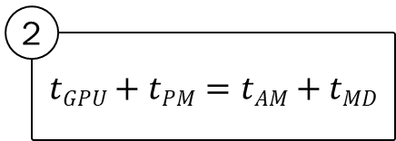
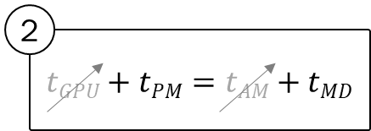
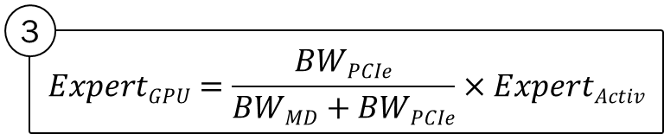
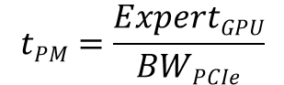
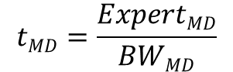

GPU-MoNDE Load-balancing
Overlap GPU and MoNDE pipelines
Load-balancing Scheduler (Host CPU Runtime)
1
1
2
3
$${Expert}_{Activ}={Expert}_{GPU}+{Expert}_{MD}$$
GPU Memory
MoNDE Memory
MoNDE NDP
Expert FFN
Expert FFN
Expert FFN
Expert Parameter Movement
NDP Expert Load
GPU
MoNDE Device
Notes:
To answer this question, we implement a load-balancing scheduler that overlaps the GPU and MoNDE pipelines.
Recall that the GPU pipeline consists of expert parameter movement followed by GPU expert processing, whereas the MoNDE pipeline consists of activation movement, near-data expert processing and another activation movement.
//
Our scheduler balances the latencies for expert parameter movement of the GPU pipeline, and the expert parameter load time of the MoNDE pipeline, which are the main sources of latency for the two pipelines.
//
We formulate the two latencies as the expert parameter sizes divided by the bandwidths of the PCIe and MoNDE device memory, which can be obtained through system profiling.
//
The scheduler follows three steps :
//
First, the MoE gating function determines the total number of activated experts, which is the sum of the experts to be processed on the GPU and the MoNDE Near-Data Processor.
//
Next, the latencies of the GPU and MoNDE pipelines are equated.
//
We remove the GPU expert processing time and the activation movement time because they are relatively small.
//
Using the two equations obtained from the previous steps, the scheduler estimates the optimal number of the top hot experts to offload to the GPU.

Slide 14
GPU-MoNDE Load-balancing
Minimally moves expert parameters & Utilize GPU-NDP parallelism
Time
Streams
GPU
+ MoNDE
GPU
g
PCIe
a
a
g
Gating
MoNDE
e
e
e
e
e
Expert
e
p
PMove
GPU
+ MoNDE
+ Load-balancing
GPU
g
e
e
a
AMove
PCI_{M→G}
p
p
a
PCI_{G→M}
a
MoNDE
e
e
e
Computation Overlap
Notes:
GPU-MoNDE load-balancing reduces the total latency by minimally moving expert parameters // and overlapping the computations of the GPU and the MoNDE near-data processor.

Slide 15
Evaluation Setting
Integrate Pytorch implementation with in-house cycle-accurate simulator
System
Processor | NVIDIA A100 GPU | MoNDE
Compute (BF16) | 312 TOPS | 2 TOPS
Memory | 80 GB 2 TB/s | 512 GB 512 GB/s
PCIe | PCIe gen4 32 GB/s
Workload
Model | Switch Transformers (Top-1 gating) | NLLB-MoE (Top-2 gating)
Experts per MoE | 128 (each 8.4 MB) | 128 (each 33.6 MB)
Layers (Non-MoE/MoE) | 24 / 24 | 36 / 12
Model Size (Dense/MoE) | 1.1 GB / 51.5 GB | 5.7 GB / 103.1 GB
Task | XSum (Summarization) | FLORES-200 (Machine Translation)
Notes:
For our evaluation, we implement the MoNDE pipeline using Pytorch, and integrate it with an in-house cycle-accurate simulator that models the MoNDE Near-data processor.
We do this by first running MoNDE functions with the CPU and replacing the associated latencies with that of the simulated MoNDE near-data processor.
//
Our test system includes an NVIDIA A100 GPU and a simulated MoNDE device with 512 GB capacity and 512 GB/s memory bandwidth.
The processing power of the near-data processor is 2 Tera-operations per second.
//
We test Switch Transformers and NLLB-MoE models on a summarization task and machine translation task, respectively.

Slide 16
Evaluation
MoNDE achieves 4.9× and 1.5× speedups for the encoder and decoder
Notes:
MoNDE achieves on average, 4.9× and 1.5× speedups for the encoder and decoder over the existing parameter offloading technique.
//
For the encoder which activates dozens of experts for each batch, MoNDE offers large improvements by avoiding large expert movement overheads.
//
The decoder operation activates only k experts for each batch.
//
MoNDE marginally underperforms the baseline offloading scheme for the smaller Switch Transformers and batch size 1.
In this case, the expert fetching overhead for the expert offloading scheme turned out to be smaller than the slowdown incurred by MoNDE’s activation movement and near-data processing, because the size of the expert transfer is small.
//
For the larger batch size and the larger NLLB-MoE model, MoNDE shows increasing improvements over the offloading technique.
This is because of three factors : more expert transfers are required for larger batch sizes, the NLLB-MoE has larger expert size, and the NLLB-MoE requires top-2 gating, meaning that 2 expert activations are required for processing a single token.
//
Our results indicate that MoNDE is more effective for larger MoE models, larger batch sizes, and larger top-k gating.

Slide 17
Conclusion
MoNDE enables large-scale MoE inference
Utilizes near-data processing on emerging CXL memory devices
Replaces movement of massive experts with relatively cheap activations
Leverages the GPU and NDP collaboration for efficient inference
Resource-efficient solution over multi-GPU settings
Notes:
This slide concludes our work.
//
MoNDE enables large-scale MoE inference by utilizing near-data processing on emerging CXL memory devices.
It replaces movement of massive experts with relatively cheap activations and leverages the GPU and NDP collaboration for efficient inference.
Furthermore, MoNDE is a resource-efficient solution, since a single MoNDE device could replace multiple GPUs in terms of memory capacity and still provide low inference latency.

Slide 18
Thank you!
For more information and discussions
Contact : taehyunzzz@snu.ac.kr
More details available in paper
Cost analysis of parameter and activation movement
MoNDE device architecture and programming model
Evaluations on model sensitivity and CPU
Notes:
For more information on our work, please refer to our paper or reach out to the authors for discussions.
Thank you!

Slide 19
GPU-MoNDE Communication
P2P protocols enables direct CXL-to-GPU communication (e.g., GPUDirect)
Host CPU
System
Memory
Host CPU
System
Memory
CXL I/F
CXL I/F
①
2 memory copies
required
PCIe Bus (BW↓)
PCIe Bus (BW↓)
②
①
GPU
MoNDE Device
GPU
MoNDE Device
CPU Intervention
P2P Communication

Slide 20
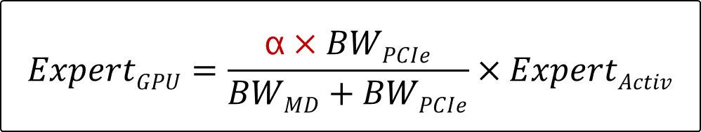
Modifying the Load-balance Formula
For increased computational demands, offload more experts to the GPU
Add a scaling factor that considers the total number of tokens to process

Slide 21

Formulation of GPU and MoNDE Workflow
$t_{GPU Workflow} =t_{PCIe}+t_{GPU}={Expert}_{all}×\frac{{4d}_{model}^{2}}{{BW}_{PCIe}}+\frac{{8×Tokens×d}_{model}^{2}}{20 TFLOPS}$
$t_{MoNDE Workflow}=t_{AMove}+t_{MoNDE}$
$\frac{2Tokens}{{BW}_{PCIe}}+\frac{{{Expert}_{all}×4d}_{model}^{2}}{BWMD}$(Memory-bound → Read expert parameters from memory)
$\frac{2Tokens}{{BW}_{PCIe}}+\frac{{8×Tokens×d}_{model}^{2}}{2 TFLOPS}$ (Compute-bound → Compute expert operations)
Streams
Time
GPU
+ Parameter
Movement
GPU
g
e
e
e
e
e
Gating
PCIe
p
p
p
p
p
g
Mem. Dev.
e
Expert
GPU
+ MoNDE
GPU
g
p
PMove
PCIe
a
a
a
AMove
MoNDE
e
e
e
e
e

